Slide 1

Real Estate Price Forecasting with Big Data & M.L.
Onur Can
QMBU 520 - Big Data for Business and Public Sector
Koc University
Research Paper Presentation

Slide 2
TABLE OF CONTENTS
1
2
Economic Concepts
Real Estate Features
The backbone of Business Value Understanding & Modeling
The characteristics that define a Real Estate’s Price
3
4
Data Sources
Modeling
What is the Data that is used to create Value?
Different approaches to the Business Problem
5
6
Zillow Case
Take Aways
A Real Estate Price Forecasting Disaster
From the Zillow Case and overal Real Estate Forecasting Idea

Slide 3
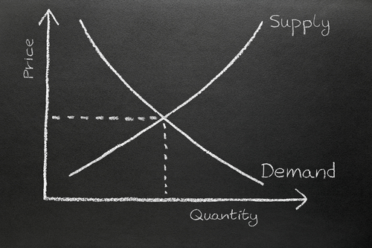
Economic Concepts
1
The backbone of Business Value Understanding & Modeling

Slide 4
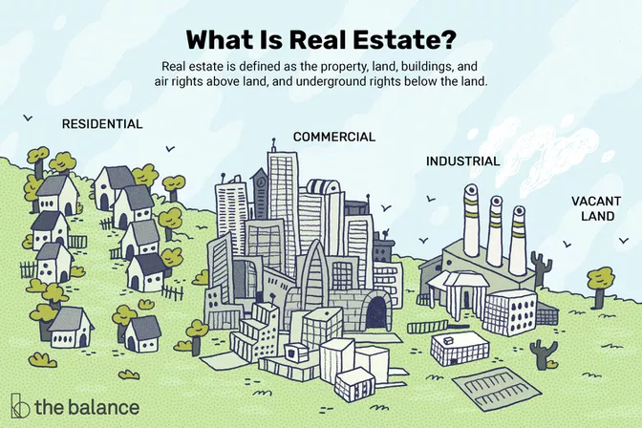
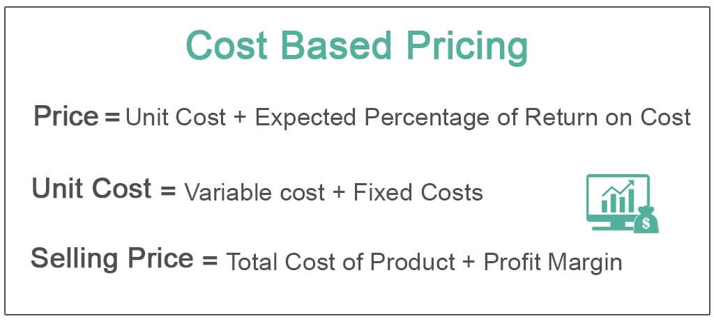
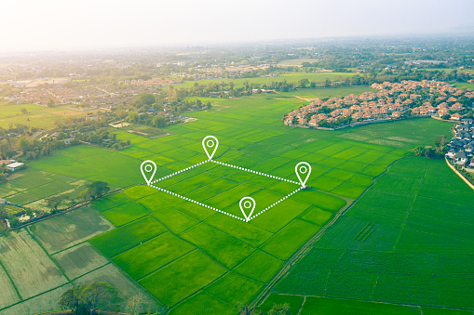




Real Estates & Prices
What is Real Estate?
How do Prices determined for Goods & Services?
Basically the inputs that required to produce it + profit
Perceived Value by the Customer! PROFIT!
Demand and Supply
Economic Conditions
Terminology Alert
Lets visualize this from groud zero to purchase
=

Slide 5

Business Problem What is the value that can be created?
The purchasing Real Estate is a big investment for both daily people and companies
Everbody values features of a real estate differently!
The real estate market is highly volatile due to economic conditions!
There are years of property purchase/sales data to investige!
The current real estate price predictions are done with real estate consultants.
?
Business Problem: There are always gaps between real price of a real estate and its listing price due to perceived value and fluctuations in economics conditions. Additionaly, due to human interaction price evaluation process is slow.
Value: Understanding and modeling this behavior offers arbitrage opportunities or smart purchases head of the market.
Terminology Alert

Slide 6

Real Estate Features
2
The Characteristics that define a Real Estate’ Price

Slide 7

Price Determinants
Hard Features
Domectic Economic Conditions
1
3
These are features that are widely accepted as critical for most of the people.
Home size and Condition
Age and Condition
Upgrades and updates
Current Economic conditions in a given time influences the prices
Interest rates
Government Policies / Subsidies
Price
Soft Features
Global Economy
These are features that might be critical for some people and for some others they might not.
The quality of local schools
Employment opportunities
Proximity to shopping, entertainment, and recreational centers
2
4
Factors that shapes international markets
Events such as Pandemic
Global Recession or Expansion

Slide 8

Data Sources
3
What is the Data that is used to create Value?

Slide 9




Data Sources
What is the Data that is used to create Value?
What is the Data that is used to create Value?
All the historical sales records
All the listed/delisted real estate prices
Real Estate Consultancy Reports
Where can we collect Data?
Most of the sales records are publicly available such as
Government Notery Informations
Third Party Websites
except business expert reports which can provide
needed knowledge for targeted area.

Slide 10

Modeling
4
Different Models to approach the Business Problem

Slide 11
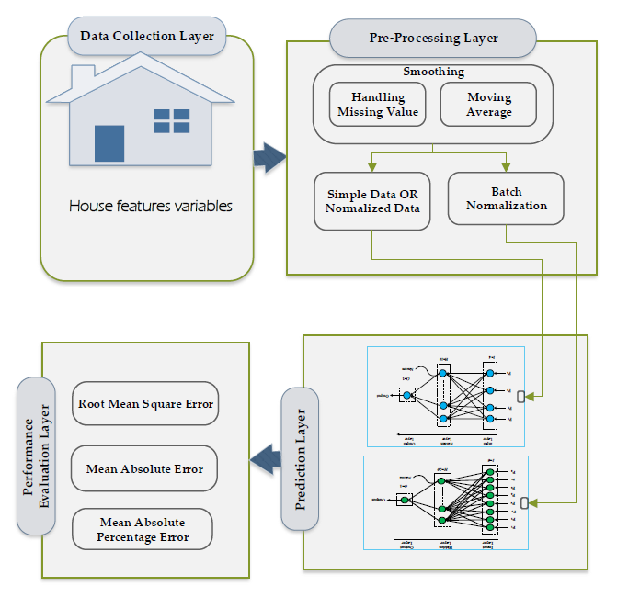
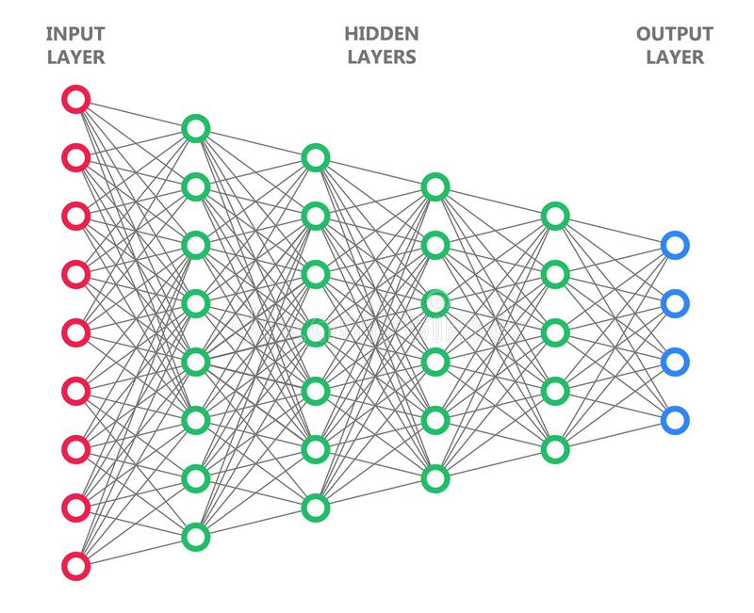
Different Models
What is the Data that is used to create Value?
Approaches used for house price prediction can be classified as:
Regression models,
machine learning models
hybrid models.
All of them has different constructions and accuracy evaluations but one observations is common in:
They need hidden parameters(layers) to capture non-linear patterns between features.
Remember our discussion in Features Part?
This is why we need multi-layered Neural
Networks!

Slide 13
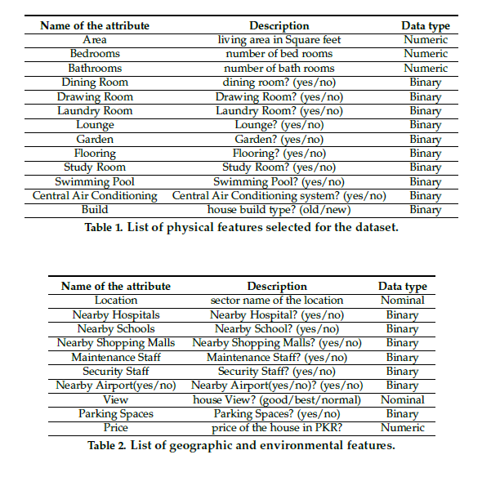
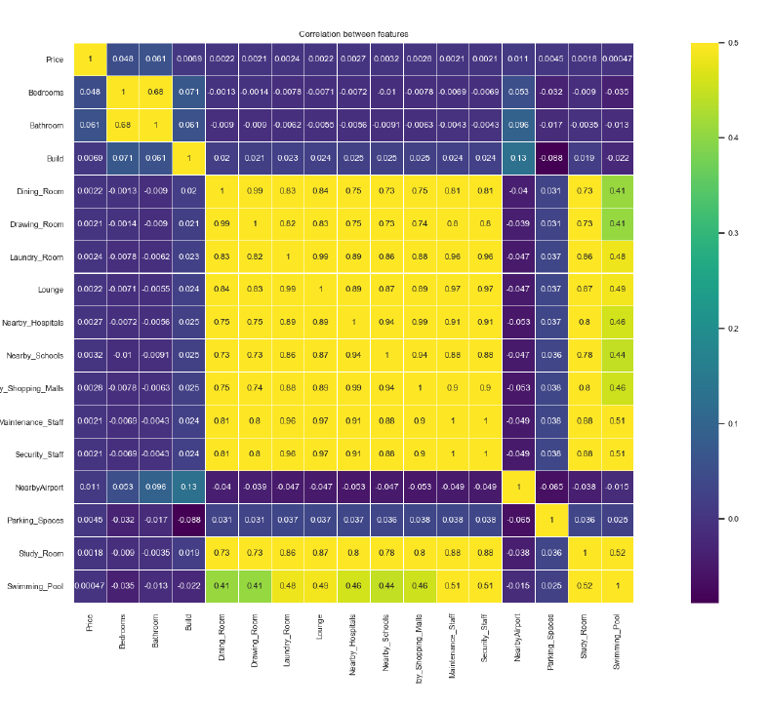
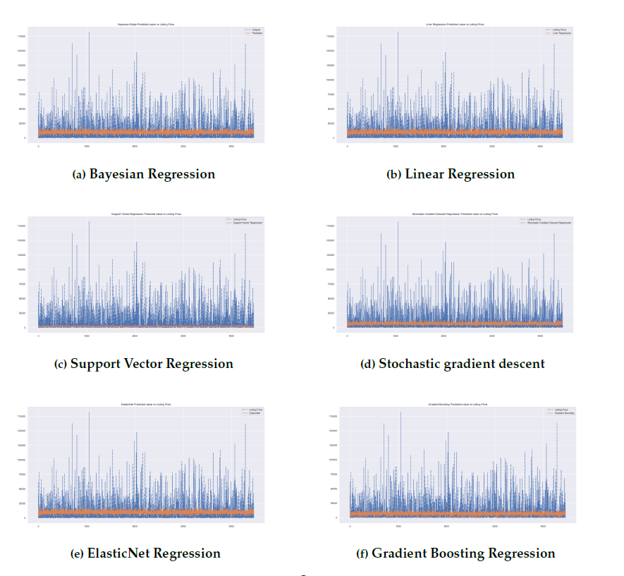
Different Models
What is the Data that is used to create Value?
Example Input Data
Data
Pre-processing
Original listing price vs Predicted price values
Source: Using Machine Learning Algorithms for Housing Price Prediction

Slide 14

Zillow Case
5
A Real Estate Price Forecasting Disaster

Slide 15
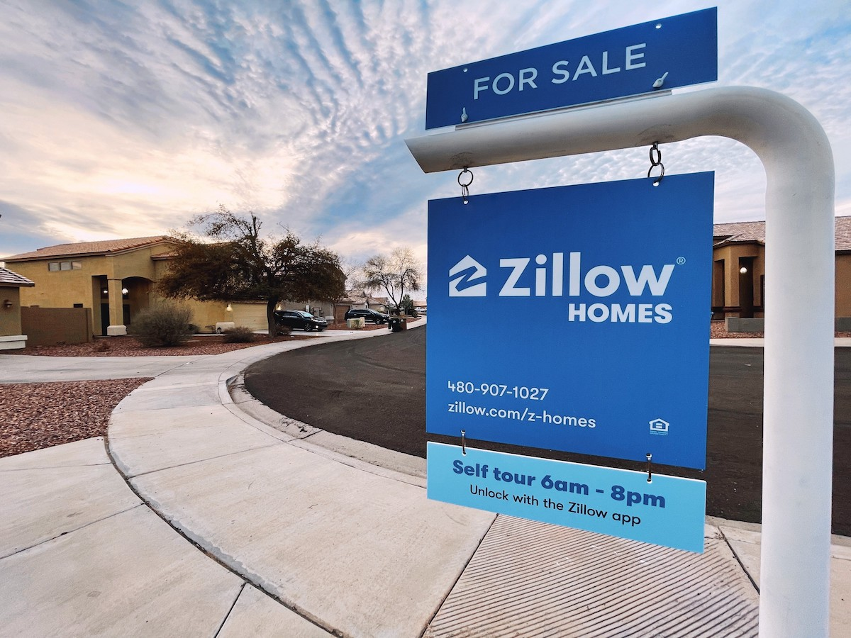
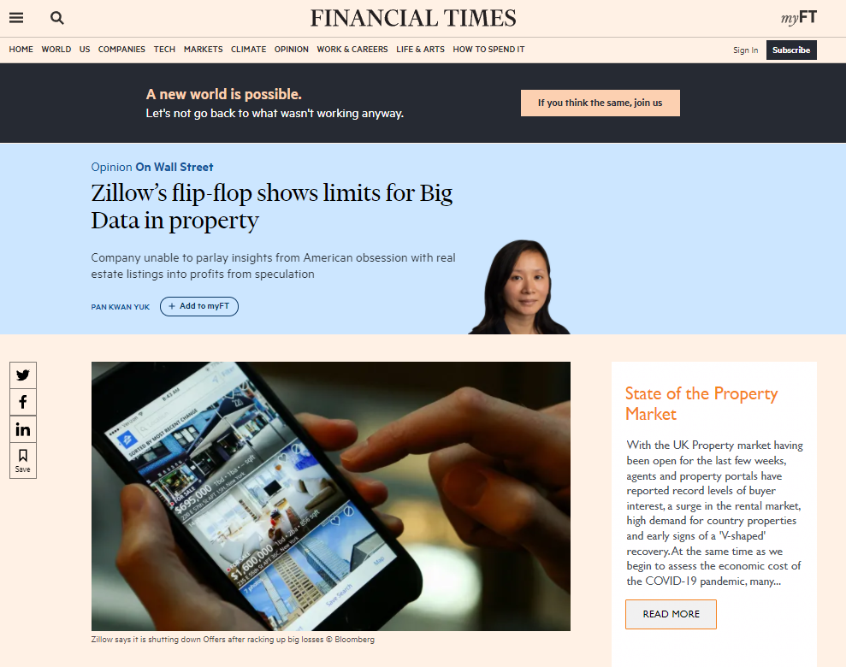
Zillow Case
Automating everything does not always make sense!
The story starts with Zestimate, a tool that used data sources to create an approximate value of properties by Zillow.
They want to take advantage of this tool via «Flipping houses» which involves buying a property at a lower value, spending on improvements and renovations and then selling it at a higher price.
Although started nice, afterwhile Zillow’s prediction model started degrading. This resulted in company buying properties at a much higher price than they were able to sell them for.
At the end,
CEO Barton announced that:
Zillow would stop purchasing homes – at a time when it already owned more than 7,000 overpriced houses.
The real estate company has decided to sell all its inventory with a discount and lay off about 25% of its 8,000 employees.
Lost $420 million in 2021’s third quarter.
Terminology Alert
Reasons for this failure will be explained in Take-Aways Section

Slide 16

Take Aways
6
Zillow Case and overal Real Estate Forecasting Idea

Slide 17

Lessons Learned
Zillow Case
Real Estate Forecasting
Machine learning (ML) model is only as good as the input data. When the algorithm is fed with substandard data, the accuracy will also be likewise. Models are able to perform effectively when they are trained on quality.
The model was injected with either publicly available data or ones that were made available by its users. The company should have put greater focus on the quality of data being used to train the ML model.
The housing property market is volatile and involves a huge monetary impact. A %10 error might lead to a lot of differences. Therefore, when solving problems that come with uncertainty, it is essential to test the changes before relying on algorithms to predict the outcome.
The company should have put greater emphasis on validation of the model
As have discussed previously, there are many different features and relationships between features which Zestimate model failed to capture.
Real estate price forecasting can be generalized to any other goods or service that involves human perceived value concept such as cars or art.
Time & Geopraphy & The demographics of the area can completely change how our algorithm should work. It should be taken into account that real estate market is volatile and highly depends on economic conditions.
A third party application should not be taken as only data source. Data preparation and cleaning is even more important for real estate.
There are many different combinations of methods and feature selections that can be fed to models.
Never enough testing & validation. Parameters always need to adopt new conditions in a continuous manner.

Slide 18
THANKS!
QUESTIONS?

